Slide 1
4.1 Types of software and interrupts
The purpose and functions of operating systems

Slide 2

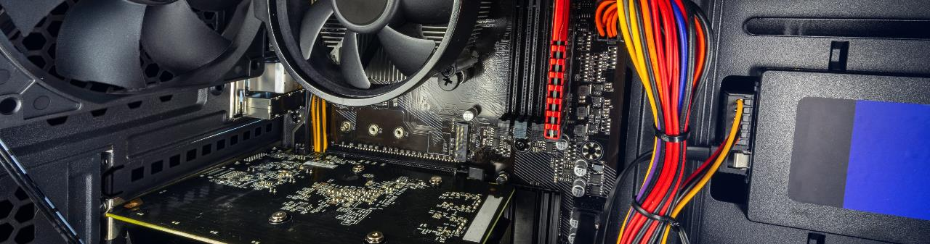
The function of operating systems
User
Operating system
Hardware

Slide 3
The function of operating systems
Operating system
User
Application software
User interface
Hardware
Utility programs
Device drivers
File management
Memory management

Slide 4
The function of operating systems
Operating system
User
Application software
User interface
Hardware
Utility programs
Device drivers
File management
Memory management

Slide 5
The function of operating systems
Operating system
User
Application software
User interface
Hardware
Utility programs
Device drivers
File management
Memory management

Slide 6
The function of operating systems
Operating system
User
Application software
User interface
Hardware
Utility programs
Device drivers
File management
Memory management

Slide 7
The function of operating systems
Operating system
User
Application software
User interface
Hardware
Utility programs
Device drivers
File management
Memory management

Slide 8
The function of operating systems
Operating system
User
Application software
User interface
Hardware
Utility programs
Device drivers
File management
Memory management

Slide 9
The function of operating systems
Operating system
User
Application software
User interface
Hardware
Utility programs
Device drivers
File management
Memory management

Slide 10

The function of operating systems
Operating system
Interrupt handling
User
Application software
User interface
Hardware
Utility programs
Device drivers
Operating system
Interrupt handling
File management
Memory management

Slide 11
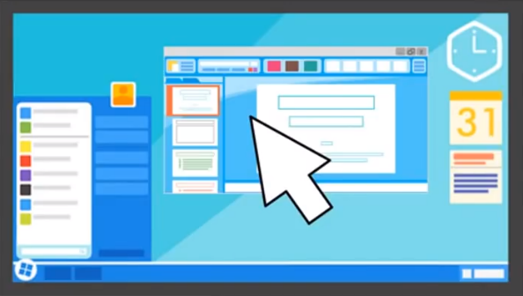
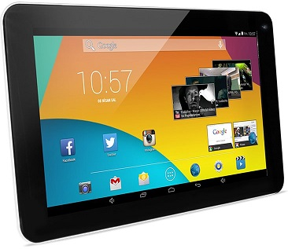
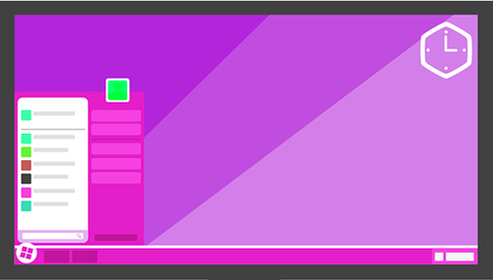
User interface: Graphical user interface (GUI)
Windows, icons, menus, pointers (WIMP)
Visual
Interactive
Intuitive
Optimised for mouse and touch gesture input

Slide 12
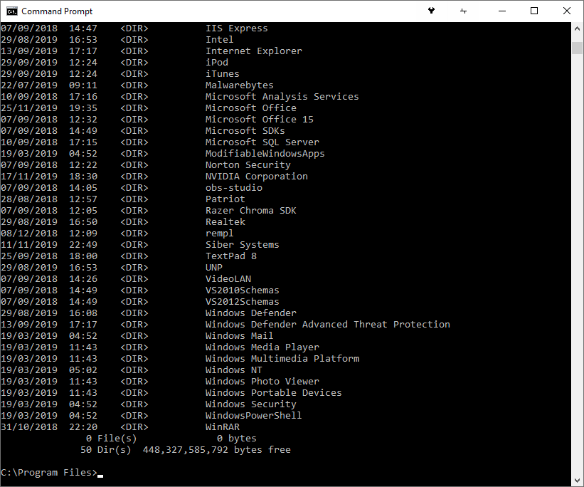
User interface: Command line
Text-based
Less resource-intensive than a GUI
More commands than a GUI
Highly efficient
Best suited for advanced users
Used to automate processes with scripts

Slide 13
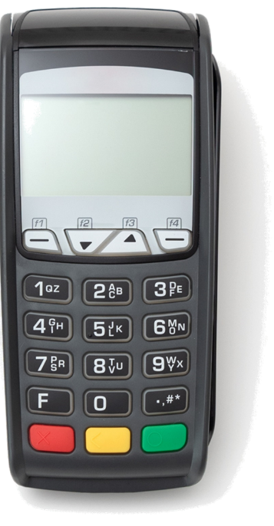
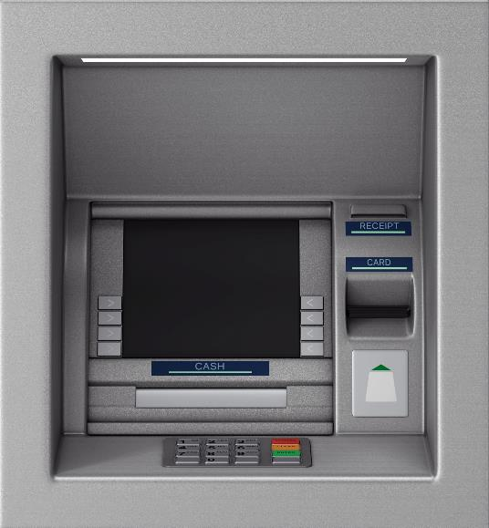
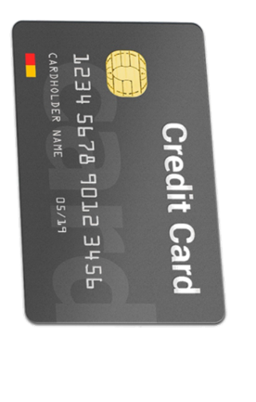
User interface: Menu
Successive menus presented to the user
Single options chosen at each stage
Often with buttons on a keypad
Gratuity?
Red – No
Green – Yes

Slide 14
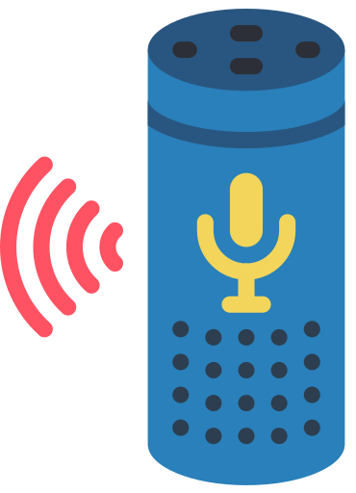

User interface: Natural language
Responds to questions in spoken language.
Not always reliable but improving all the time.

Slide 15

The purpose and functions of operating systems
An operating system provides an interface between the user and the hardware of a computing device. It provides a platform for application software to run.
The operating system performs vital roles, such as:
File management
Interrupt handling
User interface
Peripheral and driver management
Memory management
Multitasking
System security
User account management
Operating systems come with a variety of different interfaces for user interaction including:
Graphical user interface (GUI)
Command line
Menu-based
Natural language

Slide 16


